Slide 1
Welcome to FRITSCH
Company Presentation

Slide 2
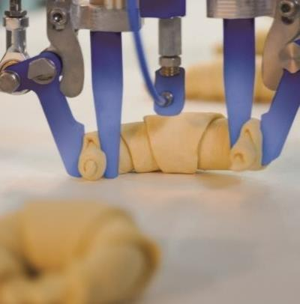
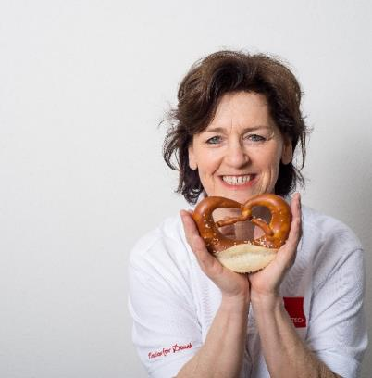
Agenda
FRITSCH at a glance
Competence
Innovation
Passion
Innovation

Slide 3
Agenda
FRITSCH at a glance
Competence
Innovation
Passion
Innovation

Slide 4
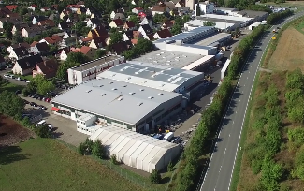
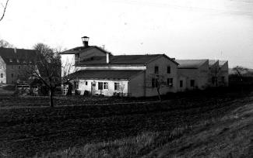
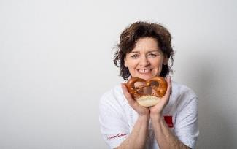
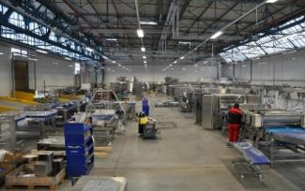
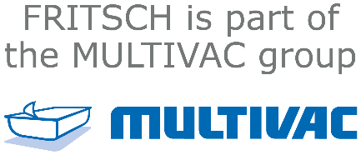
FRITSCH has been offering excellence Made in Germany for over 90 years
FRITSCH at a glance
Head Office: Markt Einersheim near Würzburg
Established: 1926 in Wiese
Employees:
ca. 500 worldwide
Production location: Germany
since 2019

Slide 5
As a part of the MULTIVAC group, FRITSCH is always around the corner
FRITSCH worldwide

Slide 6
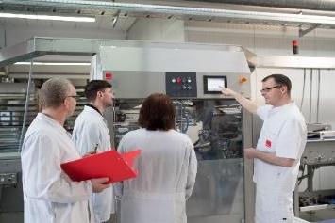
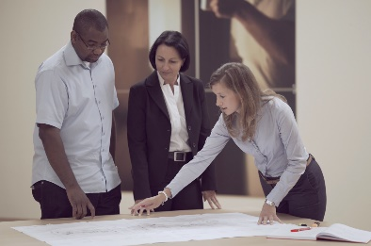
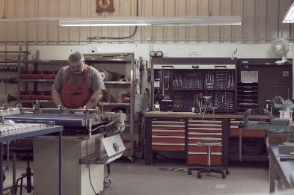
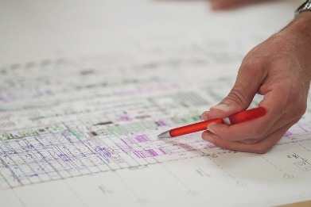
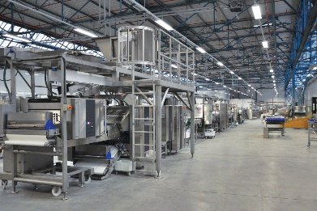
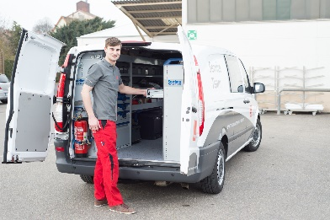
From product development to customer service – FRITSCH offers you more than just a production line
Portfolio
Product development
Consultation process technology
Machinery and plant construction
Engineering
Complete production lines
Customer Service

Slide 7
Agenda
FRITSCH at a glance
Competence
Innovation
Passion
Innovation

Slide 8
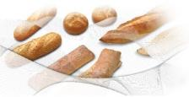
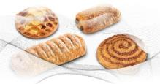
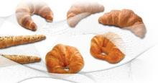
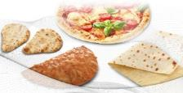
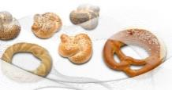
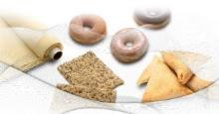
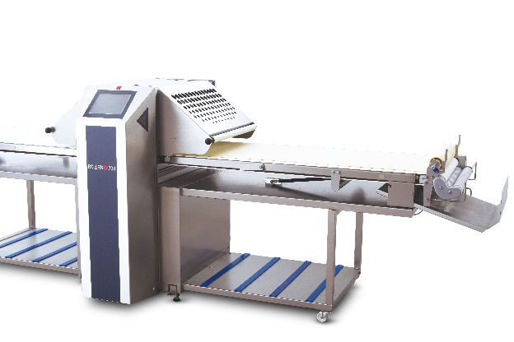
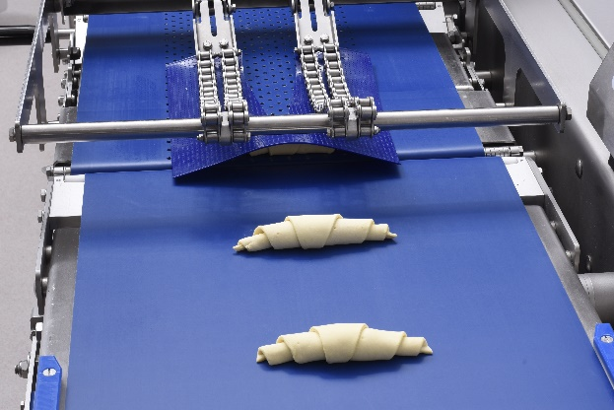
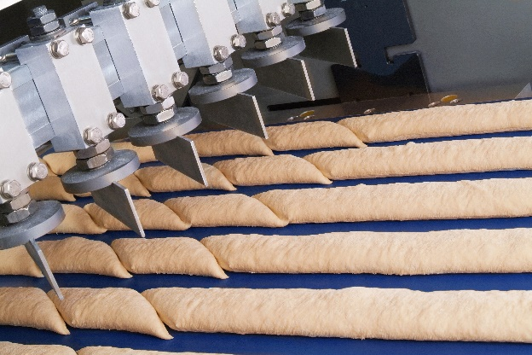
We offer comprehensive solutions for artisanal, mid-sized and industrial bakeries
Solutions
Your product – our solution
for
Artisan bakers
Medium-sized bakeries
Industrial producers

Slide 9
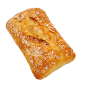
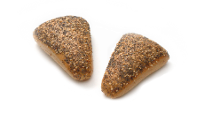
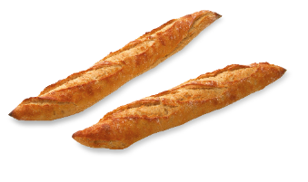
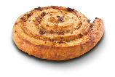
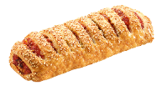
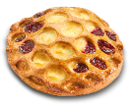
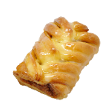
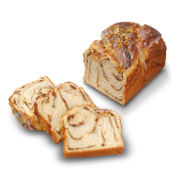
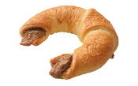
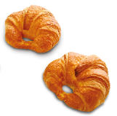
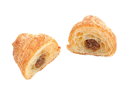
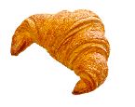
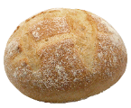
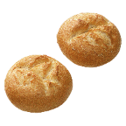
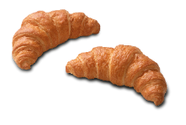
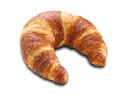
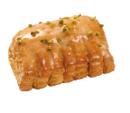
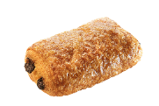
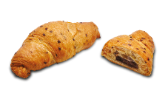
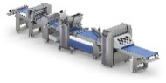
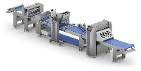
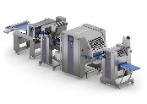
Your product – our solution
Product segments and machines
Bread & bread rolls
Pastries
Croissants & coiled products
Artisans
Artisans
Artisans
ROLLFIX
VARIOCUT S | M
ROLLFIX
VARIOCUT S | M
ROLLFIX
VARIOCUT S | M
Mid-sized
Mid-sized
Mid-sized
DOUGHLINER
LAMINATOR 700
DOUGHLINER
LAMINATOR 700
VARIOFLEX M 700
DOUGHLINER
LAMINATOR 700
VARIOFLEX M 700
MULTIFLEX
M 700
VARIOFLEX L700
MULTIFLEX
L 700
MULTIFLEX M 700
MULTIFLEX
L 700
Industry
Industry
Industry
LAMINATOR
IMPRESSA bread
LAMINATOR
IMPRESSA pastry
LAMINATOR
IMPRESSA croissant

Slide 10
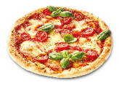
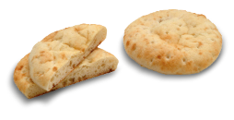
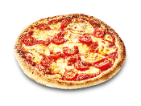
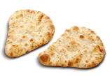
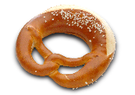
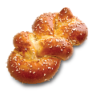
Your product – our solution
Product segments and machines
Pizza & flatbread
Twisted products
Specialities
Artisans
Artisans
Artisans
ROLLFIX
VARIOCUT S | M
ROLLFIX
VARIOCUT S | M
ROLLFIX
VARIOCUT S | M
Mid-sized
Mid-sized
Mid-sized
DOUGHLINER
EASYLINE
MULTITWIST
DOUGHLINER
LAMINATOR 700
VARIOFLEX L 700
MULTIFLEX
L 700
VARIOFLEX L 700
MULTIFLEX
L 700
Industry
Industry
Industry
IMPRESSA pizza
IMPRESSA pretzel
LAMINATOR

Slide 11
We offer sheeting machines in all different performance classes and degrees of automation
Solutions for artisanal producers
Automate and simplify your workflow.
ROLLFIX basic
ROLLFIX plus
ROLLFIX prime
VARIOCUT S | M

Slide 12
Our range of semiautomatic lines has the right solution for every need
Solutions for mid-sized producers
Our highly flexible lines adapt fully to your wishes.
DOUGHLINER
VARIOFLEX M 700
MULTIFLEX M 700
LAMINATOR 700
VARIOFLEX L 700
MULTIFLEX L 700

Slide 13
With the FRITSCH IMPRESSA lines, you produce 24/7/365 – reliably and at highest quality
Solutions for industrial producers
Automate and simplify your workflow.
IMPRESSA pizza
IMPRESSA croissant / pastry
IMPRESSA pretzel
IMPRESSA bread
LAMINATOR

Slide 14
FRITSCH After-Sales Service stands out for 9 key aspects
Services at a glance
24/7
Onsite repair
Inspection
Spare parts
Remote diagnostics
Workshop repairs
Maintenance
Training
Retrofitting

Slide 15
Agenda
FRITSCH at a glance
Competence
Innovation
Passion
Innovation

Slide 16
As a leading innovator for more than 50 years, we strive to offer you the best solution every time
Pioneering innovations
Then…
1. ROLLFIX
1. Teilfix
1. Laminating line
IMPRESSA
MULTICUT
1954
1967
1981
1987
2003
… and now

Slide 17
Even more flexibility on our IMPRESSA bread
Product Decoration Unit PDU
High-quality products by gentle dough sheet production and processing very soft doughs with a high dough yield
Very precise operation thanks to a camera system, so that the decor is applied exactly in the centre of the product
Maximum flexibility regarding product shape and weight
Little floor space required as the dough pieces do not require intermediate relaxation
High performance (up to 60 cycles /min)

Slide 18
The Soft Dough Sheeter was specially developed for processing very soft doughs
Soft Dough Sheeter SDS
Gentle forming of soft doughs with a dough yield of 165–190
Homogeneous dough sheet by constant level over the star rollers
Foldable belts in order to bring flour onto the overleaf dough sheet
No hopper, the dough is transported with conveyor belts (only small amounts of oil necessary)
Low drop heights due to horizontal retracting belt

Slide 19
The CCT punches and turns in one step for maximum accuracy of shape, position and weight
Croissant Cutting and Turning (CCT)
High capacity of up to 150 strokes per minute
Punching and turning in one step for maximum accuracy of shape, position and weight
Precise cutting thanks to an innovative, patented knife design
Quick product changes without special assembly tools and Greatest flexibility for different product sizes
Quick and easy cleaning thanks to easy access to the dough zone

Slide 20
Bending croissants automatically and precisely to specification – only on the FRITSCH CBS
Bending Robot CBS
Precise bending exactly to specification
Croissants captured by visualization system
Capacity: up to 150 cycles/min (3-stage)
Greatest product diversity for different sizes and degrees of bending (all the way to fully bent ad closed croissants)

Slide 21
The MULTITWIST, with its many tools, is much more than just a pretzel machine
MULTITWIST
Flexible and versatile; fast tool changes
Capacity: 2,000–20,000 pretzels per hour
Highest precision and process reliability
Multifunction machine (30 g – 150 g)
Maximum product variety: pretzels, rings, sticks, loops, single strand braids, knots, etc.

Slide 22
Precise coiling for filled and unfilled products with our vacuum coiling system CSVSA
Vacuum coiler CSVSA
Fastens the dough pieces from beneath using a vacuum for a precise coiling process
High capacity of up to 150 strokes per minute
System can be used for a great variety of product shapes and sizes (filled and unfilled)
Minimal energy requirements, vacuum is established only in the area of the dough piece
Accurate final position alignment

Slide 23
Agenda
FRITSCH at a glance
Competence
Innovation
Passion
Innovation

Slide 24
It‘s all about the product
FRITSCH World of Bakery

Slide 25
The WoB offers lots of space and competence for targeted development or optimization of products
FRITSCH World of Bakery
Professional baking infrastructure that covers the entire process
Complete machine program over 4,600 m²
16 master bakers for optimal support of our customers
Competent advice and comprehensive analyses
Training at the WoB or on the customer's own premises
Targeted product development together with the customer

Slide 26
Our company stands on four sustainable pillars
What FRITSCH stands for
Tradition
Passion for dough
In the world of bakery technology, the name FRITSCH has stood for excellence Made in Germany for over 90 years.
With our passion for dough, combined with our technological expertise, we develop unique solutions for our
customers.
Philosophy
Leading innovator
Our philosophy is that the machine must adapt to the dough, and not the dough to the machine. That is why we teach our machines to handcraft.
As a technological
pioneer, we help our customers to be successful by inspiring people with their baked products.

Slide 27
Max Mustermann
Stellenbezeichnung
FRITSCH Bakery Technologies GmbH & Co. KG Bahnhoftraße 27-31 97348 Markt Einersheim | Germany www.fritsch-group.com

